Slide 1

Boolean Algebra & Logic Gates
CSE 4205 Digital Logic Design
Course Teacher: Md. Hamjajul Ashmafee
Lecturer, CSE, IUT
Email: ashmafee@iut-dhaka.edu

Slide 2
Remaining to Add
Review other books and internet resources
Notes:
What is digital computer? Examples where we can use this thing.

Slide 3
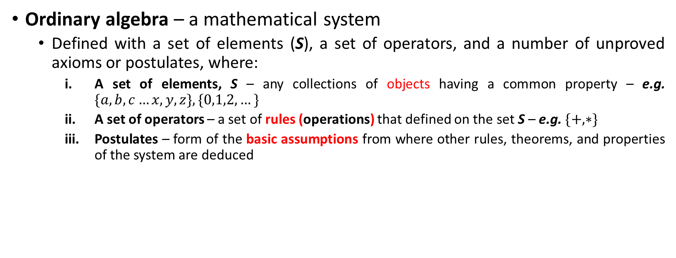
Basic Definitions
Ordinary algebra – a mathematical system
Defined with a set of elements (S), a set of operators, and a number of unproved axioms or postulates, where:
A set of elements, S – any collections of objects having a common property – e.g. $\{a,b,c…x,y,z\}, \{0,1,2,…\}$
A set of operators – a set of rules (operations) that defined on the set S – e.g. $\{+,∗\}$
Postulates – form of the basic assumptions from where other rules, theorems, and properties of the system are deduced
Notes:
Motivation of the Boolean Algebra – to making the existing circuit cheaper, simpler but equivalent to save huge cost of the design – this concept will help a student to understand the purpose of the algorithms used by software for optimization of complex circuits

Slide 4
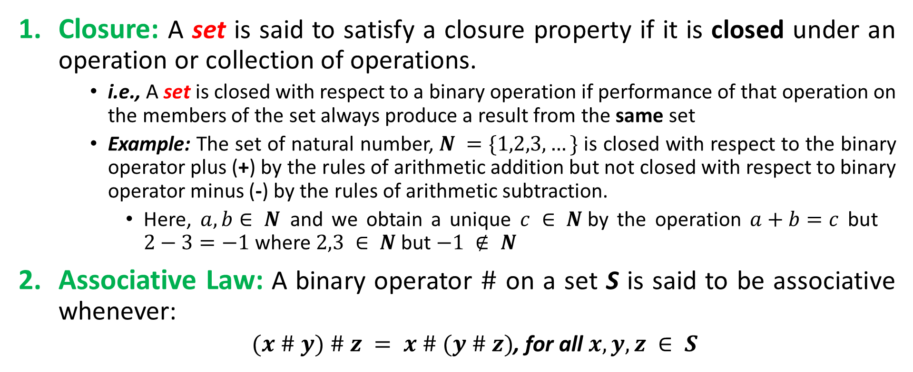
Common Postulates of a Mathematical System
Closure: A set is said to satisfy a closure property if it is closed under an operation or collection of operations.
i.e., A set is closed with respect to a binary operation if performance of that operation on the members of the set always produce a result from the same set
Example: The set of natural number, $N =\{1,2,3,…\}$is closed with respect to the binary operator plus (+) by the rules of arithmetic addition but not closed with respect to binary operator minus (-) by the rules of arithmetic subtraction.
Here, $a, b∈ N$and we obtain a unique $c ∈ N$by the operation $a+b=c$ but $2−3=−1$where $2,3 ∈ N$but $−1 ∉ N$
Associative Law: A binary operator $\#$ on a set S is said to be associative whenever:
$(x \# y) \# z = x \# (y \# z)$, for all $x,y,z ∈ S$

Slide 5
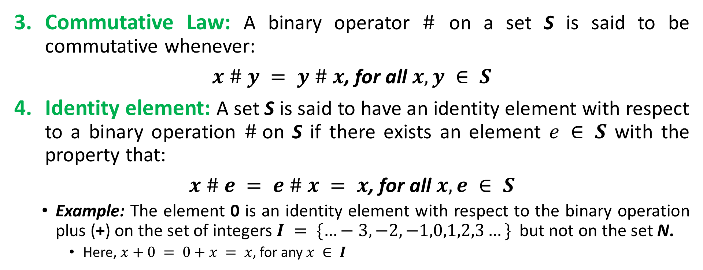
Common Postulates…
Commutative Law: A binary operator $\#$ on a set S is said to be commutative whenever:
$x \# y = y \# x$, for all $x,y ∈ S$
Identity element: A set S is said to have an identity element with respect to a binary operation $\#$on S if there exists an element $e ∈ S$ with the property that:
$x \# e = e \# x = x$, for all $x,e ∈ S$
Example: The element 0 is an identity element with respect to the binary operation plus (+) on the set of integers $I = \{…−3,−2,−1,0,1,2,3…\}$but not on the set N.
Here, $x+0 = 0+x = x$, for any $x ∈ I$
Notes:
N set does not contain 0.

Slide 6
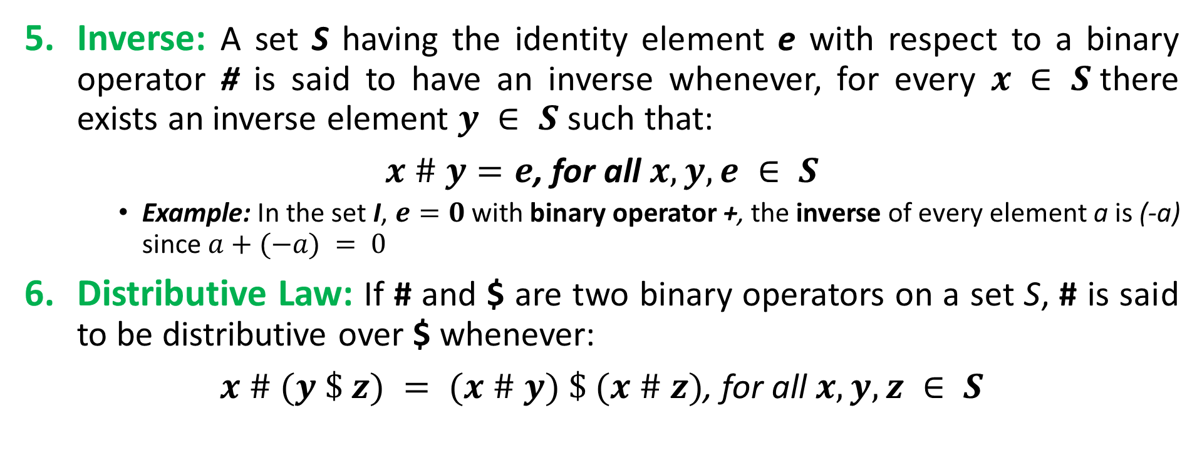
Common Postulates…
Inverse: A set S having the identity element e with respect to a binary operator # is said to have an inverse whenever, for every $x ∈ S$there exists an inverse element $y ∈ S$such that:
$x \# y=e$, for all $x,y,e ∈ S$
Example: In the set I, $e=0$ with binary operator +, the inverse of every element a is (-a) since $a+(−a) = 0$
Distributive Law: If # and $ are two binary operators on a set S, # is said to be distributive over $ whenever:
$x \# (y \$ z) = (x \# y) \$ (x \# z)$, for all $x,y,z ∈ S$

Slide 7
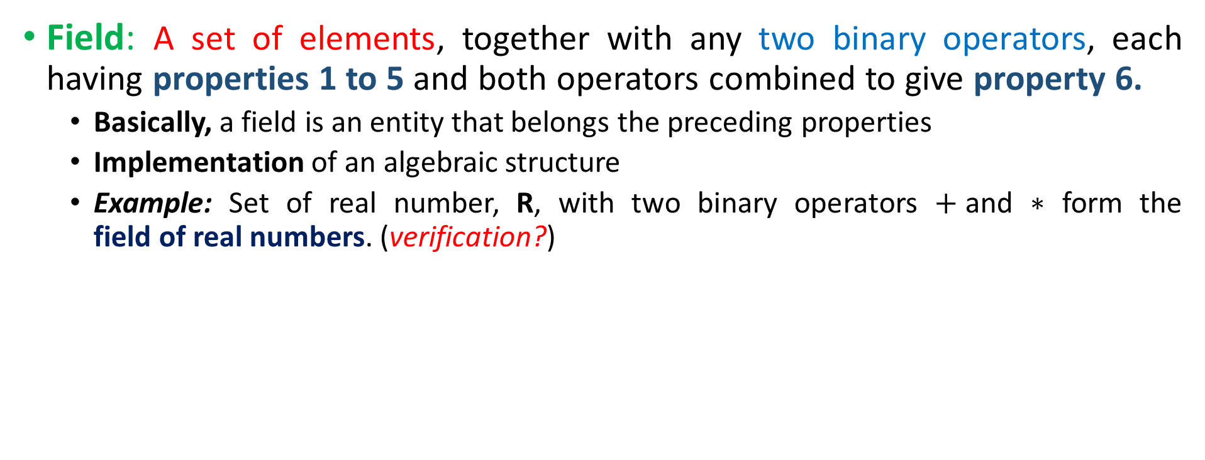
Basic Definitions - II
Field: A set of elements, together with any two binary operators, each having properties 1 to 5 and both operators combined to give property 6.
Basically, a field is an entity that belongs the preceding properties
Implementation of an algebraic structure
Example: Set of real number, R, with two binary operators $+$and $∗$ form the field of real numbers. (verification?)
Notes:
The field of the real number is the basis for arithmetic and ordinary algebra.
Verification can be done step by step following all the basic definitions and postulates mentioned in the previous slides

Slide 8
Boolean Algebra
In 1854, George Boole introduced systematic treatment of logic and developed Boolean algebra
In 1938, C. E. Shannon materialized a two-level Boolean algebra
Also called switching circuit/algebra
First introduced the properties of bistable electrical switching circuit
For formal definition of Boolean algebra, we follow the postulates formulated by E. V. Huntington (1904).
Boolean algebra is a field (implementation of algebraic structure) with a set of elements B, together with two binary operators (+) and (.) and follows the Huntington postulates.

Slide 9
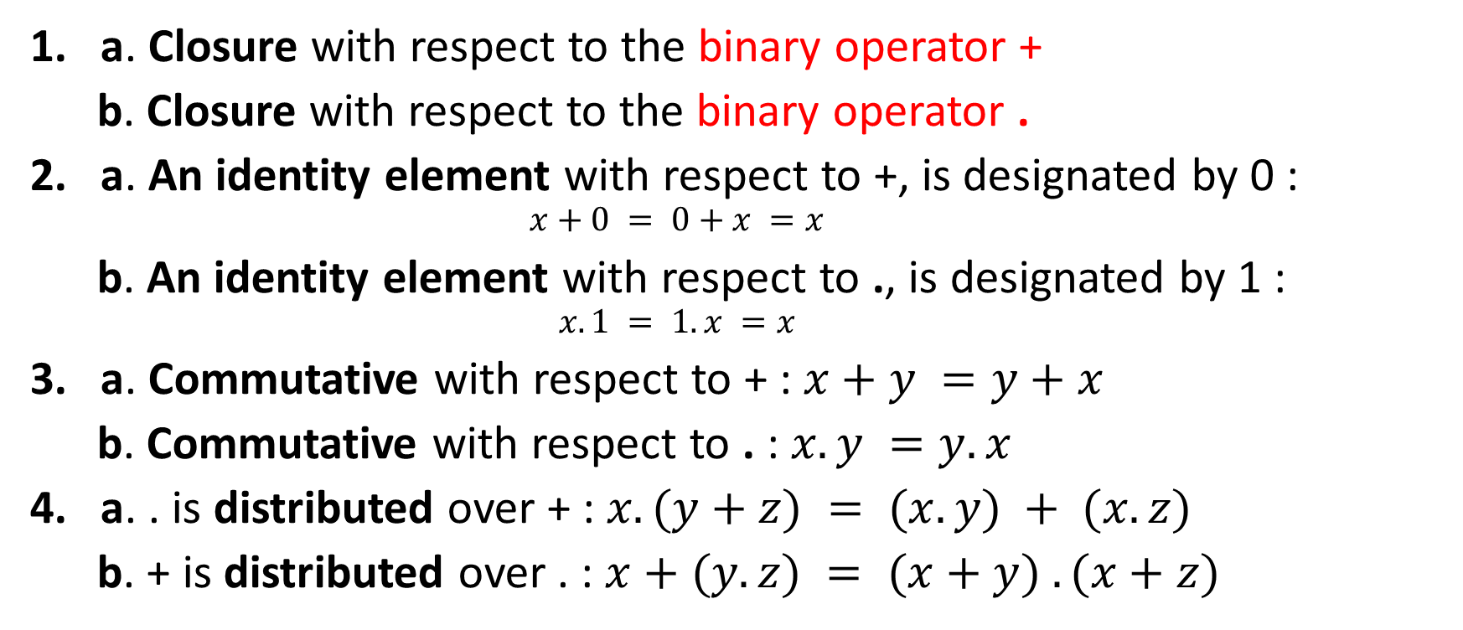
Huntington Postulates for Boolean Algebra
a. Closure with respect to the binary operator +
b. Closure with respect to the binary operator .
a. An identity element with respect to +, is designated by 0 :
$$x+0 = 0+x =x$$
b. An identity element with respect to ., is designated by 1 :
$$x.1 = 1.x =x$$
a. Commutative with respect to + : $x+y =y+x$
b. Commutative with respect to . : $x.y =y.x$
a. . is distributed over + : $x.(y+z) = (x.y) + (x.z)$
b. + is distributed over . : $x+(y.z) = (x+y) . (x+z)$
Notes:
This Huntington postulates are little bit different from the common postulates of any algebraic structure

Slide 10

Huntington Postulates…
For every element $x ∈ B$there exists an inverse element $x’ ∈ B$ (complement of x) such that
$x + x’ = 1$
$x.x’ = 0$
There exists at least two elements $x,y ∈ B$such that $x≠y$

Slide 11
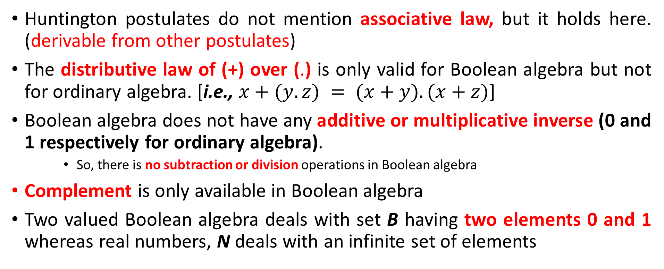
Boolean Algebra VS Ordinary Algebra Field of binary and real numbers
Huntington postulates do not mention associative law, but it holds here. (derivable from other postulates)
The distributive law of (+) over (.) is only valid for Boolean algebra but not for ordinary algebra. [i.e., $x+(y.z) = (x+y).(x+z)$]
Boolean algebra does not have any additive or multiplicative inverse (0 and 1 respectively for ordinary algebra).
So, there is no subtraction or division operations in Boolean algebra
Complement is only available in Boolean algebra
Two valued Boolean algebra deals with set B having two elements 0 and 1 whereas real numbers, N deals with an infinite set of elements
Notes:
Here, Binary number set is also an infinite set of elements which is different from Boolean algebra
Point to be noted: One should not substitute the rules of ordinary algebra by the Boolean algebra where it is not applicable
One should sincerely differentiate the elements of the set B (0 and 1) and variables of the system (a,b,c, …)

Slide 12
Two-valued Boolean Algebra
Two valued Boolean algebra is defined on a set of two elements, B = {0,1} with rules of two binary operators (+ and .)
Huntington postulates are valid for the set B and two binary operators
Slide # 9, 10 can be verified over those given circumstances
Application of Boolean algebra:
Gate type circuits
Development of theorems and properties
Also known as switching algebra, binary logic

Slide 13
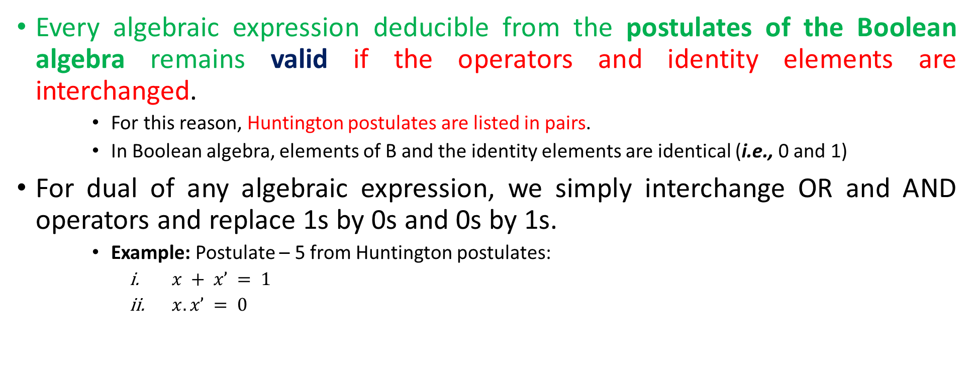
Property: Duality
Every algebraic expression deducible from the postulates of the Boolean algebra remains valid if the operators and identity elements are interchanged.
For this reason, Huntington postulates are listed in pairs.
In Boolean algebra, elements of B and the identity elements are identical (i.e., 0 and 1)
For dual of any algebraic expression, we simply interchange OR and AND operators and replace 1s by 0s and 0s by 1s.
Example: Postulate – 5 from Huntington postulates:
$x + x’ = 1$
$x.x’ = 0$

Slide 14
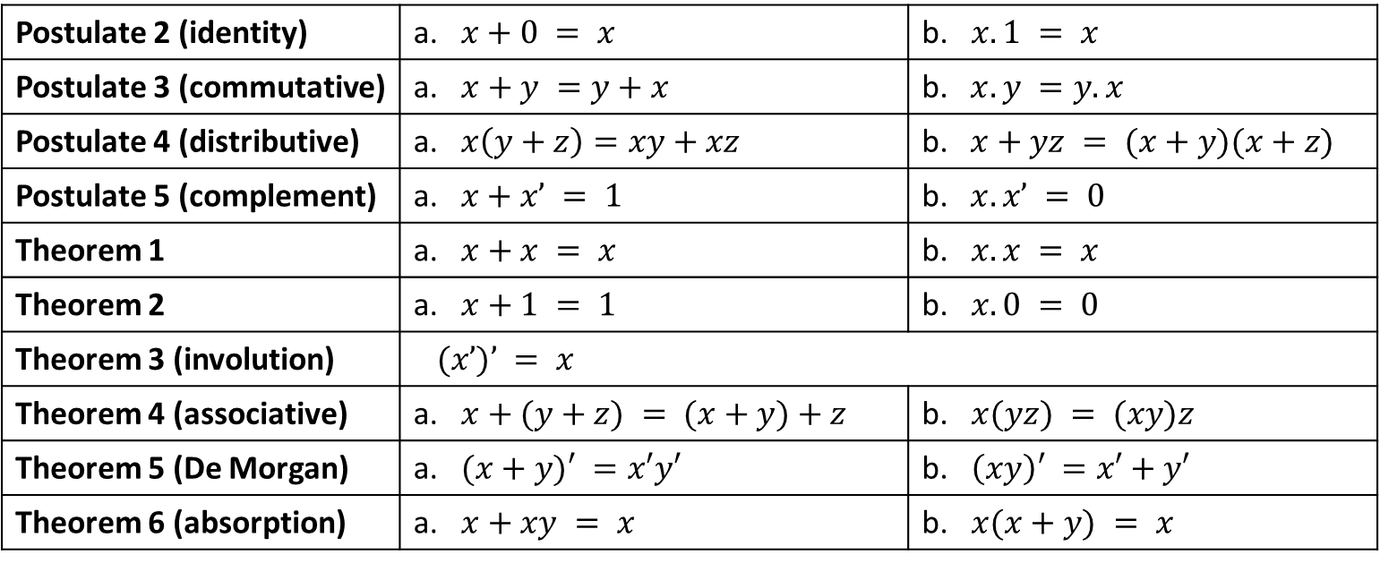
Basic Theorems
Postulate 2 (identity) | a. $x+0 = x$ | b. $x.1 = x$
Postulate 3 (commutative) | a. $x+y =y+x$ | b. $x.y =y.x$
Postulate 4 (distributive) | a. $x\left(y+z\right)=xy+xz$ | b. $x+yz = (x+y)(x+z)$
Postulate 5 (complement) | a. $x+x’ = 1$ | b. $x.x’ = 0$
Theorem 1 | a. $x+x = x$ | b. $x.x = x$
Theorem 2 | a. $x+1 = 1$ | b. $x.0 = 0$
Theorem 3 (involution) | $(x’)’ = x$
Theorem 4 (associative) | a. $x+(y+z) = (x+y)+z$ | b. $x(yz) = (xy)z$
Theorem 5 (De Morgan) | a. $(x+y)′ =x′y′$ | b. $\left(xy\right)′ =x′+y′$
Theorem 6 (absorption) | a. $x+xy = x$ | b. $x(x+y) = x$
Notes:
Postulate’s serial is started with 2,based on the Huntington postulates from slide 8, so that number is followed here for further use in proofs.
In the list, each expression is the dual with its pair.
The postulates are basic axioms which need no proof (treated as truth)
The theorems must be proven by the postulates

Slide 15
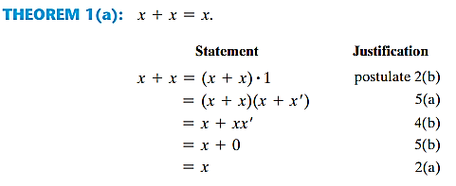
Proof of Basic Theorems

Slide 16
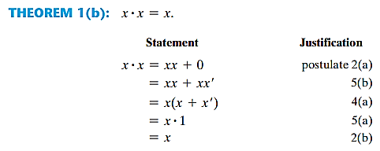
Proof of Basic Theorems…

Slide 17
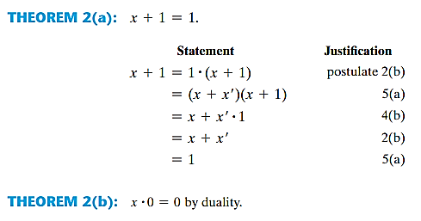
Proof of Basic Theorems…

Slide 18
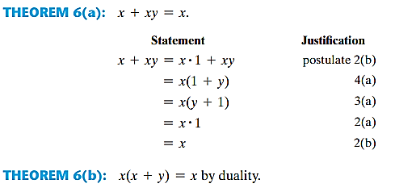
Proof of Basic Theorems…

Slide 19
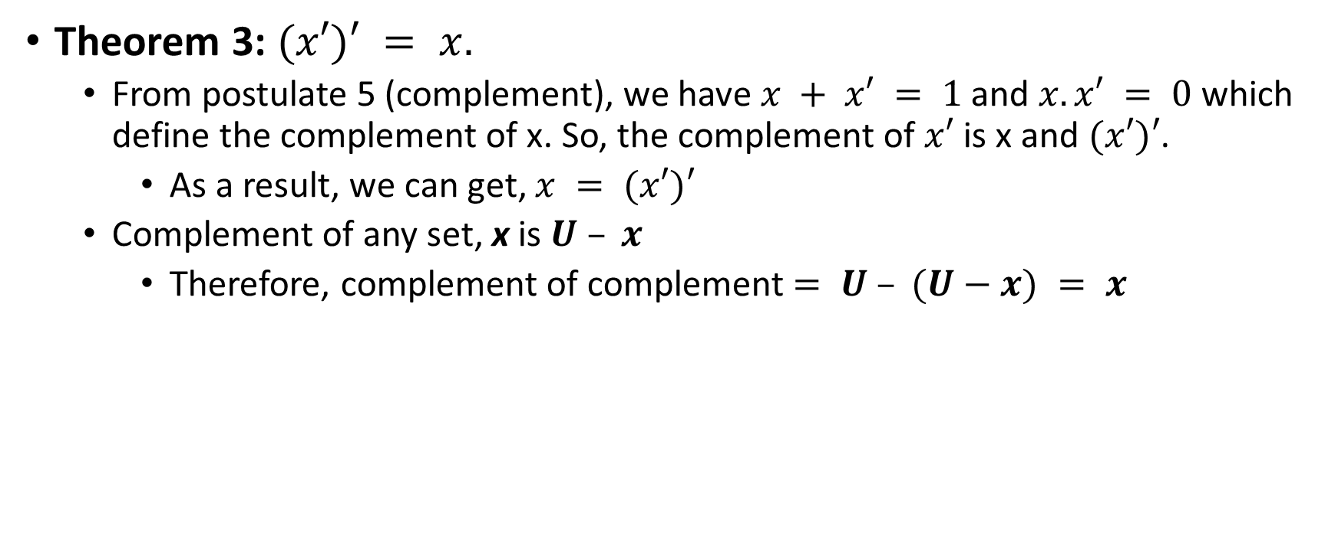
Proof of Basic Theorems…
Theorem 3: $(x′)′ = x.$
From postulate 5 (complement), we have $x + x′ = 1$and $x.x′ = 0$ which define the complement of x. So, the complement of $x′$ is x and $(x′)′$.
As a result, we can get, $x = (x′)′$
Complement of any set, x is $U – x$
Therefore, complement of complement $= U – (U−x) = x$

Slide 20
Truth Table
Theorems of Boolean algebra can be proven using truth table as well.
Both sides of the relation are checked to see whether they produce identical results for all possible combinations of the variables
The algebraic proofs of the associative law and De Morgan’s theorem are long but can be proved easily with truth tables.

Slide 21

Proof using Truth Table
Absorption Rule ($x +xy = x$):
De-Morgan's Law [$\left(x+y\right)′ =x′y′$]:
X | Y | XY | X+XY
0 | 0 | 0 | 0
0 | 1 | 0 | 0
1 | 0 | 0 | 1
1 | 1 | 1 | 1
X | Y | X+Y | (X+Y)’ | X’ | Y’ | X’Y’
0 | 0 | 0 | 1 | 1 | 1 | 1
0 | 1 | 1 | 0 | 1 | 0 | 0
1 | 0 | 1 | 0 | 0 | 1 | 0
1 | 1 | 1 | 0 | 0 | 0 | 0
Notes:
Absorption law is shown to be verified here again with truth table

Slide 22
Operator Precedence
Parentheses
NOT
AND
OR
Notes:
Ordinary arithmetic follows almost same precedence except complement and here AND and OR have to replaced by the multiplication and addition respectively.

Slide 23
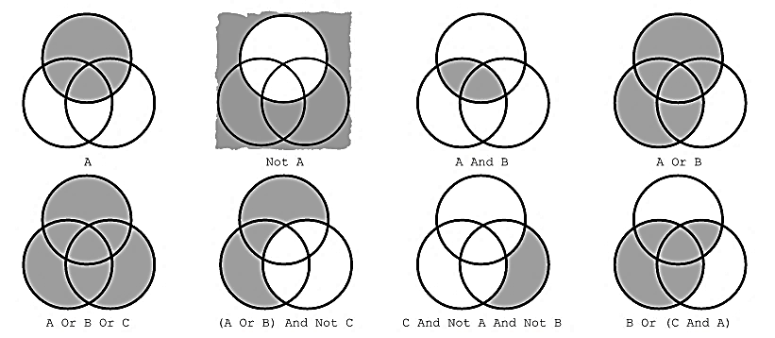
Venn Diagram
It has similarity with Boolean expressions.
A
B
C
Notes:
Here A could be rewritten as AB’C and can be detected in Venn diagram. Each term can be rewritten in different ways following the Boolean logic

Slide 24
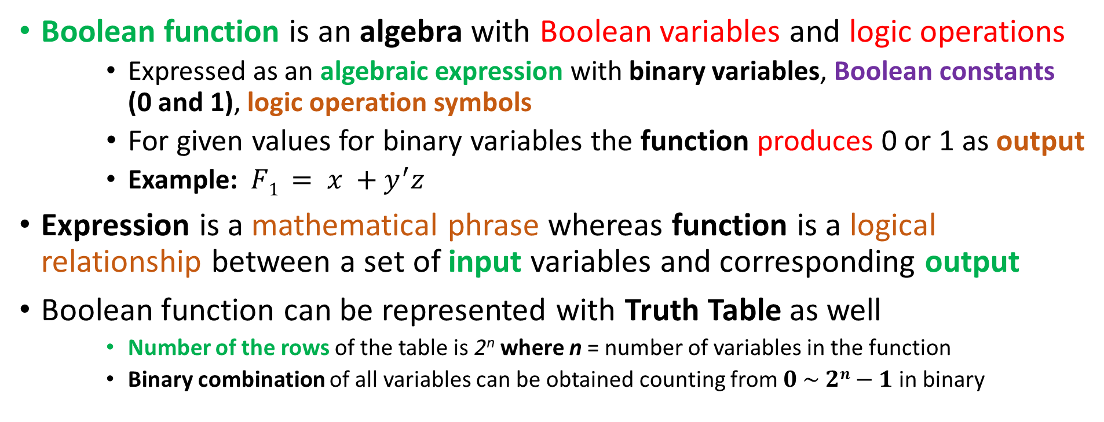
Boolean Function
Boolean function is an algebra with Boolean variables and logic operations
Expressed as an algebraic expression with binary variables, Boolean constants (0 and 1), logic operation symbols
For given values for binary variables the function produces 0 or 1 as output
Example: $F1 = x +y^{′}z$
Expression is a mathematical phrase whereas function is a logical relationship between a set of input variables and corresponding output
Boolean function can be represented with Truth Table as well
Number of the rows of the table is 2^{n} where n = number of variables in the function
Binary combination of all variables can be obtained counting from $0 \sim 2n−1$in binary
Notes:
Example of truth table can be given from previous slide about proof of theorems using truth table

Slide 25
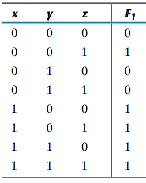
Boolean Function in Truth Table
It is obvious from the truth table that, the function is 1 when $\left(x = 1 \right)$or ($y=0$ and $z = 1)$

Slide 26
Boolean Function in Circuit Diagram
A Boolean function can be expressed with circuit diagram composed of logic gates following a particular structure
Also known as schematic diagram
Generally, variables in lowercase of the function are considered as input, and variables in uppercase as output of the circuit
Express the relationship between input and output of the circuit
Instead of listing all possible combinations of input and corresponding output like truth table, it rather indicates how to generate the output logic value from given input logic values.

Slide 27
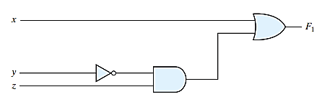
Boolean Function in Circuit Diagram: Example

Slide 28
Boolean Function: Reformation
In algebraic form, a function can be expressed in a variety of ways, all which of which have equivalent logic
Also, it can be transformed into different circuit diagrams
But there is only one way to express a Boolean function through the truth table
Note: Truth table is the only way to verify the expressions’ equivalence
The motivation of the Boolean algebra:
Manipulate a Boolean expression using rules of Boolean algebra to reduce it into a simpler expression
Thus reduce the number of gates, inputs, and interconnections in the circuit for the same function
Ultimately reduce the complexity, cost, and increase the reliability, efficiency
Finding the most economic logic representation is an important design task
Notes:
Reformation means alternative representation

Slide 29
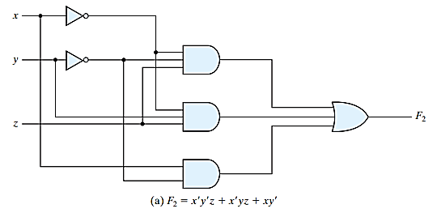

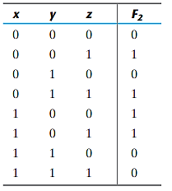
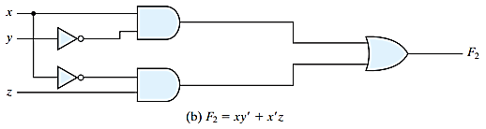
Boolean Function: Redesign - Example
Notes:
Both of the forms of the function, F₁ and F₂ have produced same truth table which confirms the equivalence between them

Slide 30
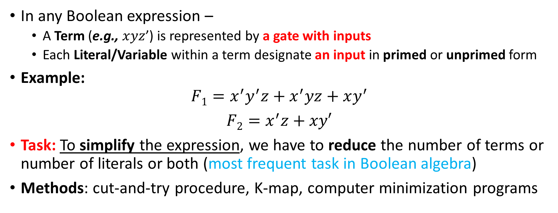
Algebraic Manipulation
In any Boolean expression –
A Term (e.g., $xyz$’) is represented by a gate with inputs
Each Literal/Variable within a term designate an input in primed or unprimed form
Example:
$$F1=x^{′}y^{′}z+x^{′}yz+xy^{′}$$
$F2=x^{′}z+xy′$
Task: To simplify the expression, we have to reduce the number of terms or number of literals or both (most frequent task in Boolean algebra)
Methods: cut-and-try procedure, K-map, computer minimization programs
(3 terms and 8 literals)
(2 terms and 4 literals)
Notes:
Cut-and-try =manual method based on basic relations and manipulation techniques but subject to human-error-prone to manipulate
computer minimization programs – its framework of different tools is based on concept of Boolean algebra
K-map – drawing method

Slide 31

Simplification of Boolean Function
Cut and Try procedure:

Slide 32

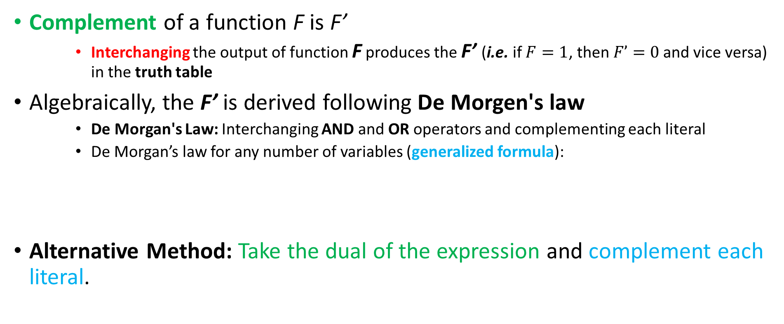
Complement of a function
Complement of a function F is F’
Interchanging the output of function F produces the F’ (i.e. if $F=1$, then $F’=0$and vice versa) in the truth table
Algebraically, the F’ is derived following De Morgen's law
De Morgan's Law: Interchanging AND and OR operators and complementing each literal
De Morgan’s law for any number of variables (generalized formula):
Alternative Method: Take the dual of the expression and complement each literal.
Notes:
Dual: For any Boolean expression, interchange OR and AND operators and replace 1s by 0s and 0s by 1s.

Slide 33
Complement of a function: Example
?
Notes:
Also try to complement those functions using their duals and complement of each literals

Slide 34
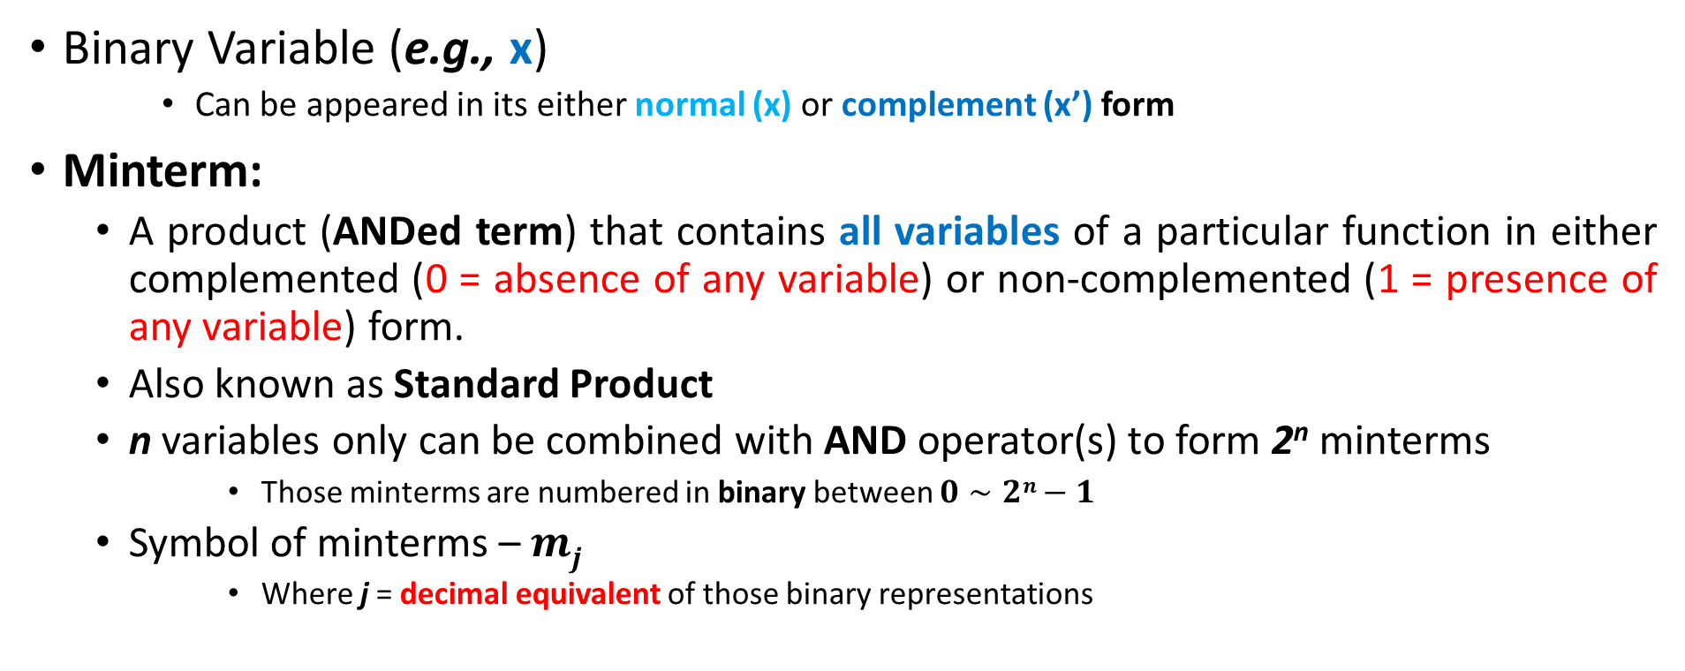
Minterms
Binary Variable (e.g., x)
Can be appeared in its either normal (x) or complement (x’) form
Minterm:
A product (ANDed term) that contains all variables of a particular function in either complemented (0 = absence of any variable) or non-complemented (1 = presence of any variable) form.
Also known as Standard Product
n variables only can be combined with AND operator(s) to form 2^{n} minterms
Those minterms are numbered in binary between $0∼2n−1$
Symbol of minterms – $mj$
Where j = decimal equivalent of those binary representations

Slide 35
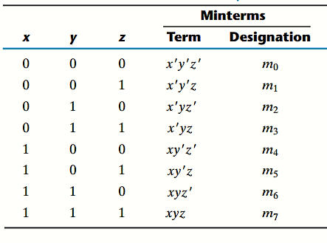
Minterms

Slide 36
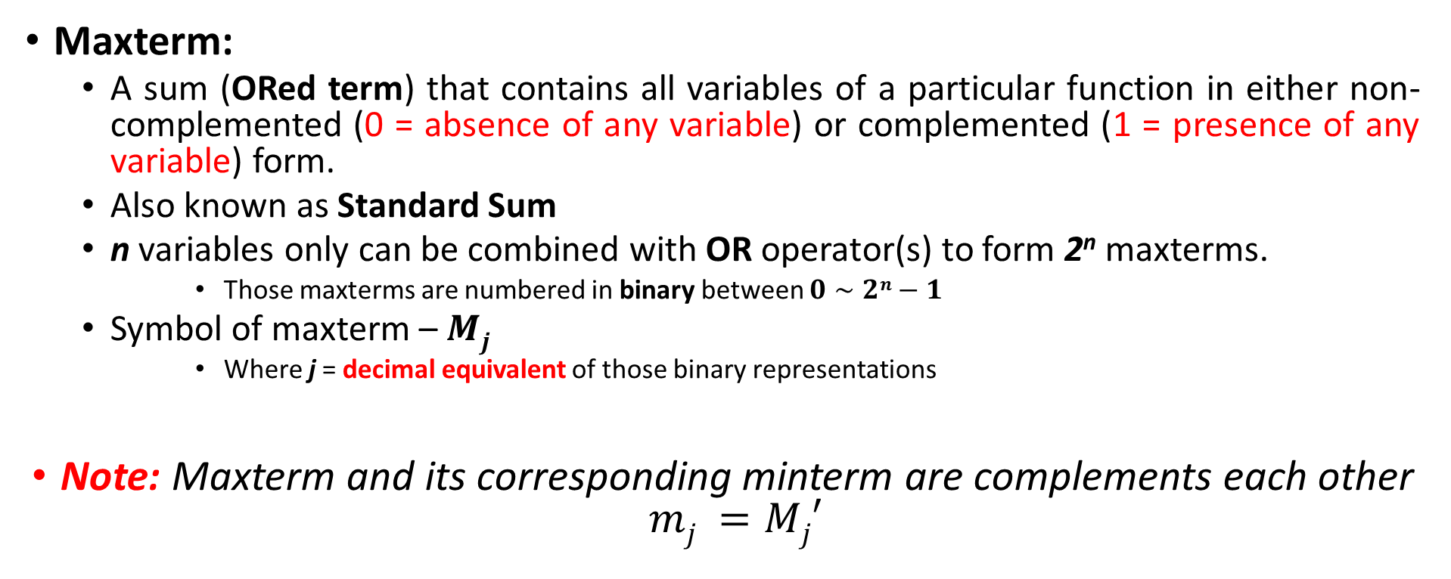
Maxterms
Maxterm:
A sum (ORed term) that contains all variables of a particular function in either non-complemented (0 = absence of any variable) or complemented (1 = presence of any variable) form.
Also known as Standard Sum
n variables only can be combined with OR operator(s) to form 2^{n} maxterms.
Those maxterms are numbered in binary between $0∼2n−1$
Symbol of maxterm – $Mj$
Where j = decimal equivalent of those binary representations
Note: Maxterm and its corresponding minterm are complements each other $mj =Mj′$
Notes:
Basically, this complement is true if we follow the De Morgan’s law:
$a’b’c’ = (a+b+c)’$

Slide 37
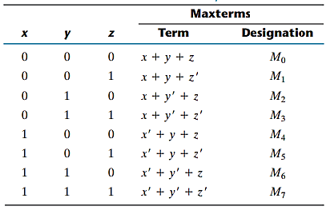
Maxterms

Slide 38
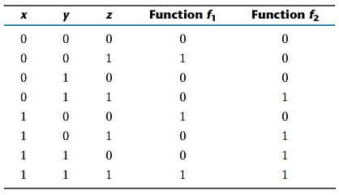

Boolean Functions Using Minterms
Expression of a Boolean function
From a given truth table, minterms are produced from those combinations of the variables which produces 1 (True) in the given function and then OR all of those minterms.
Note: Any Boolean function can be expressed as a sum of minterms
Notes:
sum of minterms = $\sum{mj}$

Slide 39
Complement of Boolean Functions
Procedure using truth table:
Taking each combinations of variables (minterms) that produces 0 (False) in the function and then OR all of those terms.
i.e. Considering those minterms which are 0 in the truth table
f₂’ = ?

Slide 40



Boolean Functions Using Maxterms
Procedure:
Taking the complement of complemented function (f₁’).
Note:
Any Boolean function can also be written as a product (AND) of maxterms.
Boolean function written as a sum of minterms or product of maxterms – Canonical form
$$(x+y^{′}+z′)$$
Notes:
Product of maxterms = $\prod{Mj}$
Canonical form = form according to the rule

Slide 41


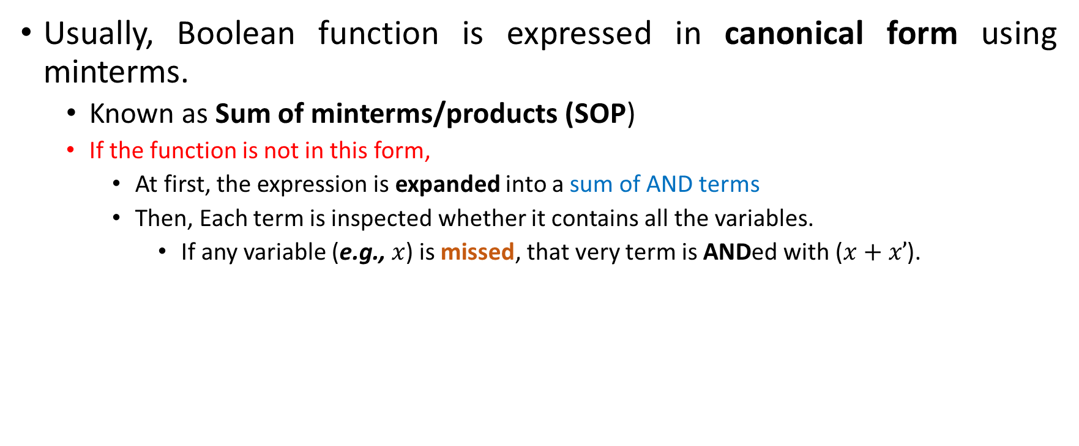
Boolean Function in Canonical Form Using Minterms
Usually, Boolean function is expressed in canonical form using minterms.
Known as Sum of minterms/products (SOP)
If the function is not in this form,
At first, the expression is expanded into a sum of AND terms
Then, Each term is inspected whether it contains all the variables.
If any variable (e.g., $x$) is missed, that very term is ANDed with ($x+x’$).
Notation 1
Notation 2
Notes:
Both notation methods are convenient to express the function
In second notation, ∑ stands for ORing the terms. Letters in uppercase are the order of the variables how they will be converted into ANDed terms

Slide 42
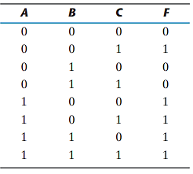

Boolean Function in Canonical Form… Using Minterms
It is also convenient to derive minterms of a Boolean function obtaining the truth table of the function directly from the expression and selecting the minterms (=1) from the truth table.
Example: $F=A+B’C$
Notes:
Both of the notation methods are convenient to express the function
In second notation, stands for ORing the terms. Letters in uppercase are the order of the variables how they will be converted into ANDed terms

Slide 43



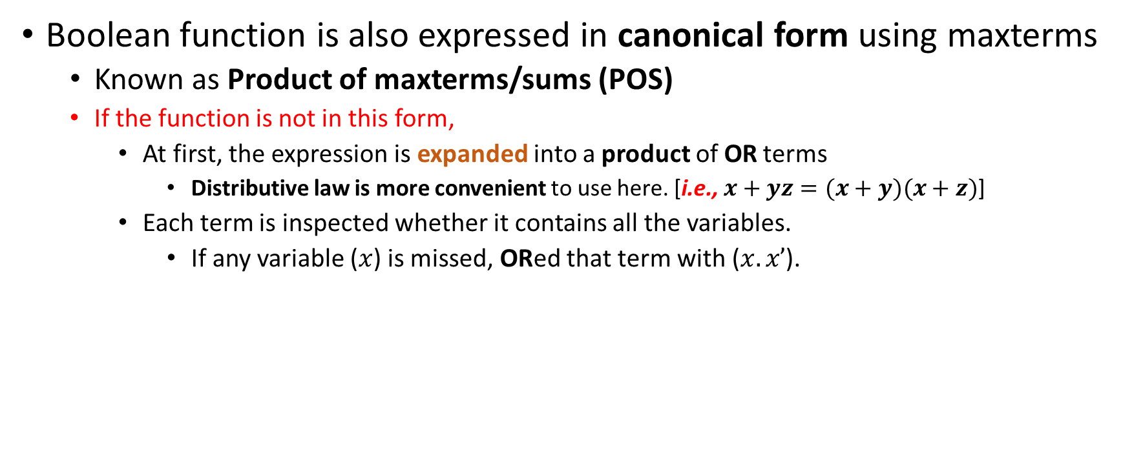
Boolean Function in Canonical Form Using Maxterms
Boolean function is also expressed in canonical form using maxterms
Known as Product of maxterms/sums (POS)
If the function is not in this form,
At first, the expression is expanded into a product of OR terms
Distributive law is more convenient to use here. [i.e., $x+yz=(x+y)(x+z)$]
Each term is inspected whether it contains all the variables.
If any variable ($x$) is missed, ORed that term with ($x.x’$).
Notation 1
Notation 2
Notes:
Both of the notation methods are convenient to express the function
In second notation, ∏ stands for ANDing the terms. Letters in lowercase are the order of the variables how they will be converted into ORed terms
It is also convenient to use truth table to produce this canonical formed Boolean function using maxterms

Slide 44


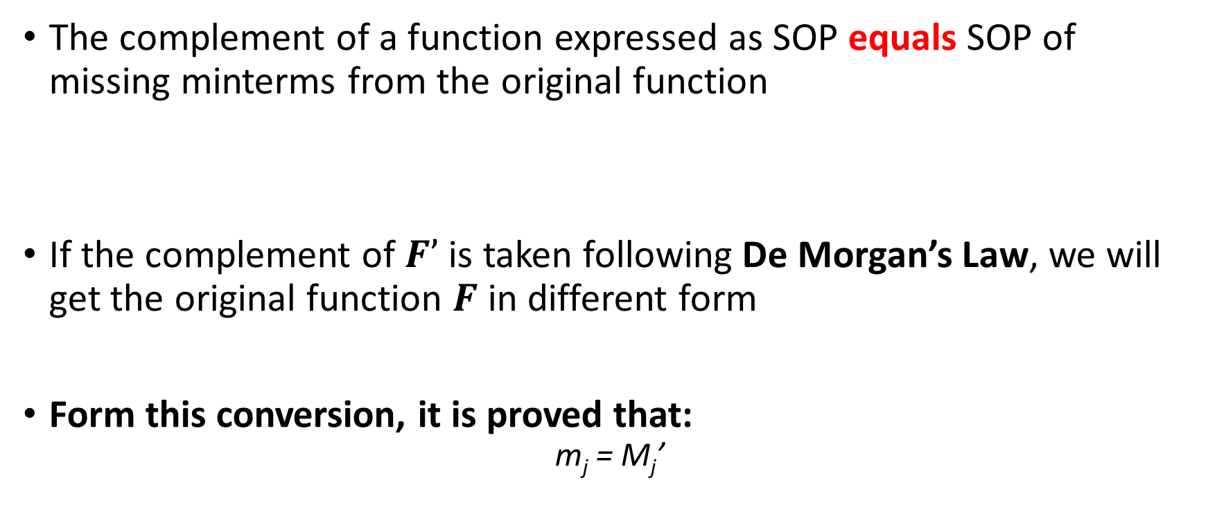
Conversions between Canonical Forms
The complement of a function expressed as SOP equals SOP of missing minterms from the original function
If the complement of $F’$ is taken following De Morgan’s Law, we will get the original function $F$ in different form
Form this conversion, it is proved that:
$$\text{m}\text{j}\text{ = }\text{Mj}\text{’}$$
Notes:
m_{j}=set of minterms which are true for our function
Mj=set of maxterms which corresponding terms are taken for minterms

Slide 45
Conversions between Canonical Forms…
General conversion procedure:
To convert from one canonical form to another, interchange the symbols ∑ and ∏ and list those numbers missing from the original form
To find the missing terms, one must realize that the total number of minterms or maxterms is 2^{n}, where n is the number of binary variables in the function

Slide 46
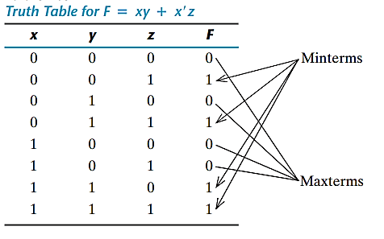


Conversions between Canonical Forms…
Another Example:
Note: In the truth table, 1’s of the function represent the minterms and 0’s represent the maxterm which
are true for the given function.

Slide 47
Standard Forms
Canonical forms:
Both are easily formed from truth table
Rarely have least number of literals (!!!)
Each minterm or maxterm must contain all variables; either primed or unprimed
Standard form:
Terms may have one, two, three or any number of literals.
Two types: SOP and POS

Slide 48


Standard Forms: SOP and POS
SOP
Has ANDed terms (products) which are finally ORed (sum)
Logic diagrams contain a group of AND gates followed by a single OR gate
It’s assumed that the complements of variables are directly available in their input
Known as two-level-implementation
POS
Has ORed terms (sums) which are finally ANDed (product)
Logic diagrams contain a group of OR gates followed by a single AND gate
It’s assumed that the complements of variables are directly available in their input
Another two-level-implementation
SOP:
POS:
Notes:
These ANDed or ORed terms may have any number of literals
This product (AND term) has the similarity with multiplication operation of ordinary arithmetic
This sum (OR term) has the similarity with addition operation of ordinary arithmetic

Slide 49
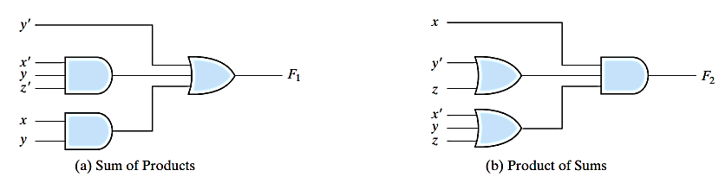
SOP and POS: Circuit Diagram Two Level Implementation
Note: It is assumed that Input variables are directly available in their complements.
Notes:
These ANDed or ORed terms may have any number of literals
This product (AND term) has the similarity with multiplication operation of ordinary arithmetic
This sum (OR term) has the similarity with addition operation of ordinary arithmetic

Slide 50

Standard Forms and Nonstandard Forms
Nonstandard form:
The Boolean expression is neither in SOP nor in POS form
May require random number of AND an OR gates
Also, the number of levels for implementation are random
Can be converted to standard form following the distributive law
Nonstandard Form:
Standard Form:

Slide 51
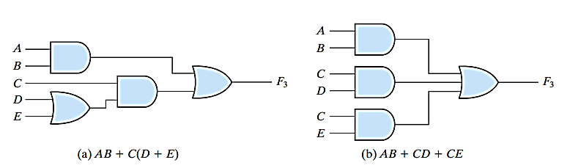
Standard Forms and Nonstandard Forms…
Notes:
Two level implementation is preferred because it produces least amount of delay to produce output from given inputs (i.e. to propagate signal).

Slide 52
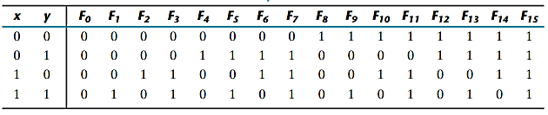

Other Logic Operations
For n number of Boolean variables-
2^{n} number of rows of combinations can be produced of a truth table
In total 2^{2n} number of different functions are possible (How?)
In figure, each column ($F0\sim F15$) represents a truth table for one possible function
These functions also could be expressed as algebraic expressions (using SOP or POS)
Notes:
These 16 functions again has been generated from 16 binary combinations of 4 variables. Here each row in the truth table stands for a Boolean variable.

Slide 53
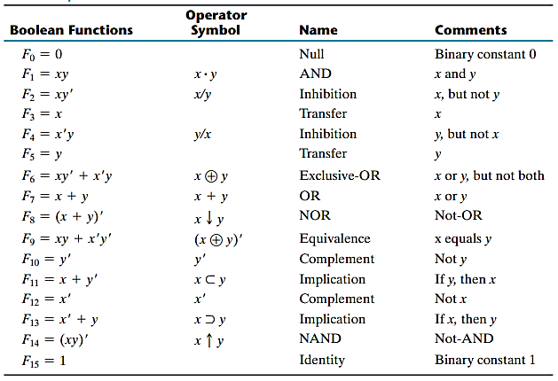
16 Boolean Functions: Algebraic Expressions
Notes:
These functions also can be expressed with algebraic expressions shown in column 1.
Some of these functions also can expressed with special operator listed in column 2.
These functions have their own name mentioned in column 3.
Inhibition - The output is true for only one variable is true when the other one is false (hindered/inhibited) is called Inhibition (inhibit/ hinder others) – Boolean expression = $xy’$ : giving chance to x only
Implication (Conditional) - an operation on two logical values, typically the values of two propositions, which produces a value of false if the first operand is true (promise) and the second operand is false (conclusion), and a value of true otherwise.
Example: If I read hard (p), I will pass (q). p->q. Only strange part is that the promise is not satisfied but the conclusion is met. It is obvious if we look at the Boolean expression for this – $p−>q =p^{′}+q$
XOR – Binary difference operator. Also complement of XNOR.

Slide 54
Other Logic Operations…
16 functions are subdivided into 3 categories:
2 functions that produce a constant 0 or 1
Constant functions
4 functions with unary operations
Complement and transfer (or buffer).
10 functions with binary operators that define eight different operations
AND, OR, NAND, NOR, exclusive‐OR (XOR), equivalence (XNOR), inhibition, and implication.
Notes:
Inhibition and implication are basically used by logician rather than computer designer.
Constant functions always produce 1 or 0
Complement function produces the complement of a single binary variable (x or y)
Transfer function produces the equal value to a single binary variable (x or y)
NAND = Not AND
NOR = Not OR
X-OR = difference operator
X-NOR = equivalence operator
X-OR and X-NOR are complement to each other

Slide 55
Digital Logic Gates
Boolean functions are usually implemented with AND, OR, NOT gates
Consideration to construct other logic gates:
Feasibility and economy of producing gates with physical components
The possibility of extending the number of inputs more than two
Basic properties of binary operator like commutativity and associativity
The ability to implement Boolean function alone or in conjunction with other gates

Slide 56
Digital Logic Gates: Candidates
Among 16 functions from previous table with two variables
2 functions are constants
4 functions are repeated
Only 10 functions left to be considered as logic gates
Implication and Inhibition don't follow the associative and commutative laws.
Impractical to use as standard logic gates
So, others are used as standard gates in digital computer design
i.e., Complement, transfer, AND, OR, NAND, NOR, XOR, XNOR

Slide 57
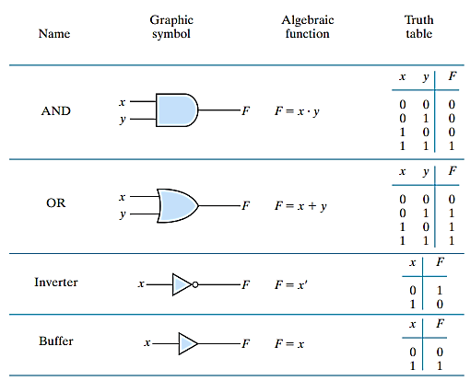
Digital Logic Gates: AND, OR, NOT, Buffer
Notes:
Small circle in the output (bubble) designates the logic complement.
The triangle designates the buffer function: used for power amplification of the signal and is equivalent to two cascaded inverts
But they Don’t produce any logic operation

Slide 58
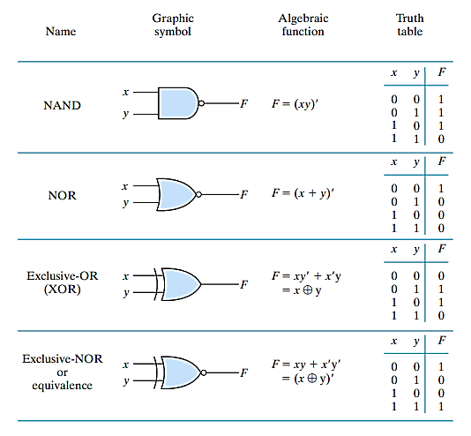
Digital Logic Gates: NAND, NOR, XOR, XNOR
Notes:
Small circle in the output (bubble) designates the logic complement.
NAND and NOR are used extensively as standard logic gates and more popular than AND and OR because
They are easily constructed with transistors
Digital circuits are easily implemented with them

Slide 59


Extension to Multiple Inputs: Problem
A gate (other than inverter and buffer) can be extended to have multiple inputs if it follows commutative and associative laws (e.g., OR)
NAND and NOR are commutative and not associative so we can’t extend them into multiple inputs in traditional way. (e.g., NOR)

Slide 60
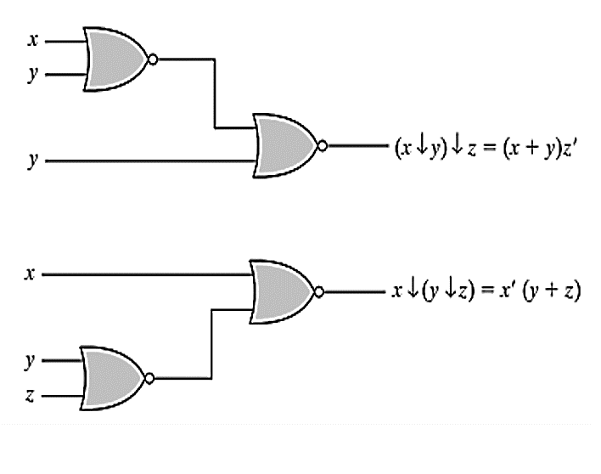
Extension to Multiple Inputs: Problem - NOR
z

Slide 61

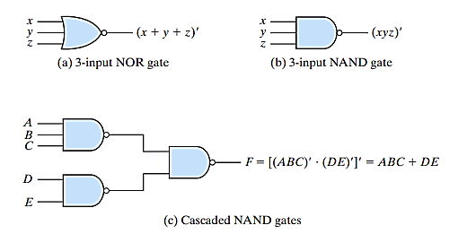
Extension to Multiple Inputs: Redefinition
To overcome this problem, we should define the multiple NOR (or NAND) gate as a complemented OR (or AND) gate:

Slide 62
Extension to Multiple Inputs: Attention
In cascaded NOR and NAND operations, we should use the parenthesis properly to make the sequence correct:
Notes:
From the figure, it is obvious that a Boolean function expressed as SOP form (e.g., $ABC + DE$) can be easily implemented with NAND gates.

Slide 63
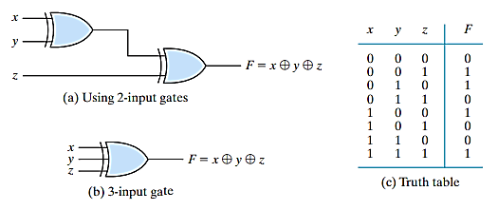
Extension to Multiple Inputs: XOR and XNOR
Both are associative and commutative
But definition can be modified different way:
XOR – Odd function considering 1
XNOR – Even function considering 1, exclusively complement of XOR
Notes:
But in some articles, multiple input XNOR is the complement of the that multiple input XOR gate and makes it even function considering 1. But it will not follow the associative rules then.
In some articles, it is observed that XNOR is defined as Even function considering 0s.

Slide 64
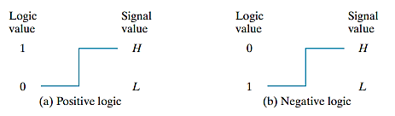
Positive and Negative Logic
Binary signal at inputs and outputs has one of two values
Logic 1 and Logic 0
Except during transition
There are two different assignments of analog signal levels (High and Low) to these logic values
Assigning logic values to its relative amplitudes of signal levels – sometimes both amplitudes may be considered as either positive or negative – So actual amplitude is not that much informative
If High (H) level represents logic 1 – positive logic system
If Low (L) level represents logic 1 – negative logic system

Slide 65
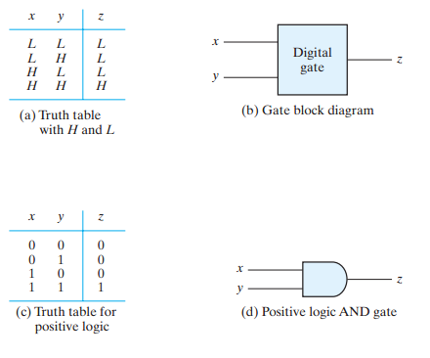
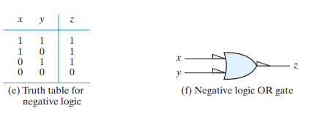
Positive and Negative Logic…
Notes:
Small triangles in input and output designates negative logic – same gate can be worked as AND and OR gate
Follow the duality principles

Slide 66
Integrated Circuits
Digital circuit constructed with integrated circuit
IC – small die (dice) of semiconductor crystal named as chip based on what other components are embedded
Components of Chip – transistors, diodes, resistors, capacitors and so on
These components are interconnected inside
This chip is mounted (organized) on a ceramic/plastic package and connections are made of external pin
Differ from other detachable electronic circuit (with registers, capacitors)
Designation of IC printed on the surface

Slide 67
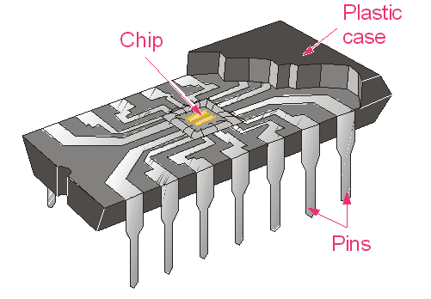

Integrated Circuits…
Advantages:
Small in size
Cost effective
Reduced power consumption
High reliability against failure
Linear and Digital IC – for continuous signal and discrete signal respectively from external sources
Two types of packages:
Flat
Dual in Line
Notes:
Digital and Linear IC looks same

Slide 68

Types of ICs: Complexity
Based on the number of gates inside (complexity) –
SSI – with several independent gates with their inputs and outputs (<10)
MSI – for specific elementary operations – decoder, encoder, adder, etc. (10 ~1000)
LSI – include digital system like processor, memory chip, etc. (>10,000)
VLSI – include complex microcomputer chip due to low cost and smaller in size (>1M)
Notes:
Todays we ICs as ULSI as well

Slide 69
Types of ICs: Technology
TTL - transistor–transistor logic (standard)
ECL - emitter‐coupled logic (high speed)
MOS - metal‐oxide semiconductor (high component density)
CMOS - complementary metal‐oxide semiconductor (lower energy)

Slide 70
Digital logic family: Distinguishing Parameters
Parameters in digital logic families:
Fan out = maximum number of output signals
Fan in = maximum number of input signals
Power dissipation
Propagation delay
Noise margin

Slide 71
Extension to Multiple Inputs…

Slide 72
Extension Multiple Inputs…

